Slide 1
Session 1 of Data Science II
Notes:
Thank you everyone for joining these multi-sessions workshop on using data science frameworks,libraries and tools mainly in Python to explore in details how to start making your own Machine Learning projects. This course, I assume that most of you have at least basic understanding of Python, declaring functions, loops, importing libraries etc… I won’t go in detail in the python code unless it is vital. After this sessions ends if what you see is giberish, let me know and I will try to give you some extra python resources to get you up to speed.
Anyone, My name is Ahmed Al-Manji, I worked as technical analyst of startups and currently Master’s Student in Data Science. I hope that you will learn enough from me that will bootstrap your Data science, or machine learning career path.

Slide 2
Topics for Today
Data Science, Machine Learning, AI, Reinforcement Learning? WHAT ARE THEY?
Introduction to Colab, Jupyter
Exploratory Data Analysis (Recap from Last Module)
Frameworks and Libraries
Practice session with Titanic Dataset
Notes:
First I would try to differentiate what is data science and other buzz words people are using and then will go directly on practical session where you will see me code through the titanic datasets to explore the data, analyze it and basically get it ready for probably your first machine learning project.

Slide 3
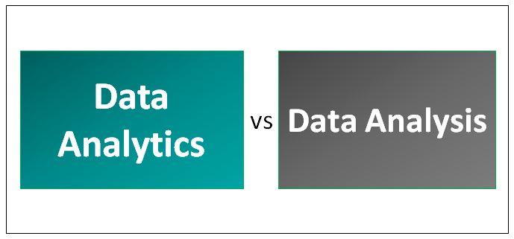
Data Science
Notes:
First I would try to differentiate what is data science and other buzz words people are using and then will go directly on practical session where you will see me code through the titanic datasets to explore the data, analyze it and basically get it ready for probably your first machine learning project.
Data science is all about data, and I’m pretty sure you already knew that. But what I mean is that it involves statistics such probability, std, means t-test, z-tests and all that math I am pretty most forgot about.
But Let’s separate Data science into two fields Analytics and Analysis. Both requires data, however, on data analysis is you are basically looking back in past data and trying to analyze and make explanation for example what days most people go to the cinema. And even like what time does people arrive to Salalah by Car? All of this is on the past.
On the other side, you have analytics, which is basically taking all the data in the past and trying to make predictions what’s gonna happen in the future, for example. You estimate that on next month 1000 people will go the cinema, while Sunday, 600 people, just as an example.

Slide 4
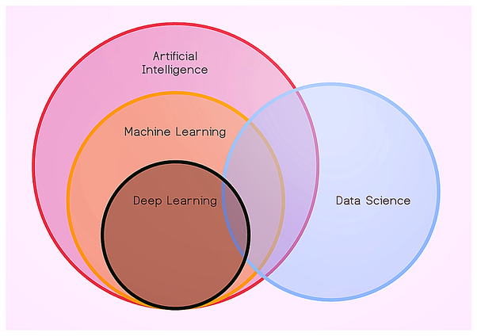
The Buzz Words
Notes:
Now how is Data science related to all other buzzwords:
Basically we are using data techniques to get the data clean and analyze what we are looking for etc… and then use algorithms to predict what’s next.
One way of defining AI is that it’s a collection of mathematical algorithms that make computers understand relationships between different types and pieces of data such that this knowledge of connections could be utilised to come to conclusions or make decisions that could be accurate to a very high degree.
Machine Learning (ML) is considered a sub-set of AI. You can even say that ML is an implementation of AI. So whenever you think AI, you can think of applying ML there when there is enough data. We will talk more about ML tmw inshallah.
Deep Learning is normal terms basically Machine Learning on steroids, where when you have a lot, and I mean a lot of data you can use it and also when you want the accuracy to be very very high.
So ML use cases examples is predicting sales or when Netflix tells you what you should watch next.
DL is for example Alexa or siri… And if you heard about TensorFlow or PyTorch there are basically Deep Learning tools.

Slide 5
ML Thesaurus : Dataset
Name | Age | Statistics Mark | Python Mark | Height | Second Language |  | Target (Mark) | Pass
Ahmed | 26 | 8 | 9 | 175 | Spanish |  | 9 | Pass
Khalil | 42 | 9 | 7 | 182 | Russian |  | 8 | Pass
Cholo | 33 | 8 | 9 | 170 | Swahili |  | 9 | Pass
Hamood | 29 | 8 | 6 | 178 | English |  | 8 | Pass
Some Student | 27 | 5 | 3 | 158 | German |  | 4 | Fail

Slide 6
ML Thesaurus : Observation
Name | Age | Statistics Mark | Python Mark | Height | Second Language |  | Target (Mark) | Pass
Ahmed | 26 | 8 | 9 | 175 | Spanish |  | 9 | Pass
Khalil | 42 | 9 | 7 | 182 | Russian |  | 8 | Pass
Cholo | 33 | 8 | 9 | 170 | Swahili |  | 9 | Pass
Hamood | 29 | 8 | 6 | 178 | English |  | 8 | Pass
Some Student | 27 | 5 | 3 | 158 | German |  | 4 | Fail
Notes:
Observation (or datum, or data point) is one piece of information.
In many cases the observations are supposed to be i.i.d.
● independent ● identically distributed

Slide 7
ML Thesaurus : Observation
Name | Age | Statistics Mark | Python Mark | Height | Second Language |  | Target (Mark) | Pass
Ahmed | 26 | 8 | 9 | 175 | Spanish |  | 9 | Pass
Khalil | 42 | 9 | 7 | 182 | Russian |  | 8 | Pass
Cholo | 33 | 8 | 9 | 170 | Swahili |  | 9 | Pass
Hamood | 29 | 8 | 6 | 178 | English |  | 8 | Pass
Some Student | 27 | 5 | 3 | 158 | German |  | 4 | Fail
Notes:
Observation (or datum, or data point) is one piece of information.
In many cases the observations are supposed to be i.i.d.
● independent ● identically distributed

Slide 8
ML Thesaurus : Feature
Name | Age | Statistics Mark | Python Mark | Height | Second Language |  | Target (Mark) | Pass
Ahmed | 26 | 8 | 9 | 175 | Spanish |  | 9 | Pass
Khalil | 42 | 9 | 7 | 182 | Russian |  | 8 | Pass
Cholo | 33 | 8 | 9 | 170 | Swahili |  | 9 | Pass
Hamood | 29 | 8 | 6 | 178 | English |  | 8 | Pass
Some Student | 27 | 5 | 3 | 158 | German |  | 4 | Fail

Slide 9
ML Thesaurus : Feature
Name | Age | Statistics Mark | Python Mark | Height | Second Language |  | Target (Mark) | Pass
Ahmed | 26 | 8 | 9 | 175 | Spanish |  | 9 | Pass
Khalil | 42 | 9 | 7 | 182 | Russian |  | 8 | Pass
Cholo | 33 | 8 | 9 | 170 | Swahili |  | 9 | Pass
Hamood | 29 | 8 | 6 | 178 | English |  | 8 | Pass
Some Student | 27 | 5 | 3 | 158 | German |  | 4 | Fail

Slide 10
ML Thesaurus : Feature
Name | Age | Statistics Mark | Python Mark | Height | Second Language |  | Target (Mark) | Pass
Ahmed | 26 | 8 | 9 | 175 | Spanish |  | 9 | Pass
Khalil | 42 | 9 | 7 | 182 | Russian |  | 8 | Pass
Cholo | 33 | 8 | 9 | 170 | Swahili |  | 9 | Pass
Hamood | 29 | 8 | 6 | 178 | English |  | 8 | Pass
Some Student | 27 | 5 | 3 | 158 | German |  | 4 | Fail

Slide 11
ML Thesaurus : Feature
Name | Age | Statistics Mark | Python Mark | Height | Second Language |  | Target (Mark) | Pass
Ahmed | 26 | 8 | 9 | 175 | Spanish |  | 9 | Pass
Khalil | 42 | 9 | 7 | 182 | Russian |  | 8 | Pass
Cholo | 33 | 8 | 9 | 170 | Swahili |  | 9 | Pass
Hamood | 29 | 8 | 6 | 178 | English |  | 8 | Pass
Some Student | 27 | 5 | 3 | 158 | German |  | 4 | Fail

Slide 12
ML Thesaurus : Feature
Name | Age | Statistics Mark | Python Mark | Height | Second Language |  | Target (Mark) | Pass
Ahmed | 26 | 8 | 9 | 175 | Spanish |  | 9 | Pass
Khalil | 42 | 9 | 7 | 182 | Russian |  | 8 | Pass
Cholo | 33 | 8 | 9 | 170 | Swahili |  | 9 | Pass
Hamood | 29 | 8 | 6 | 178 | English |  | 8 | Pass
Some Student | 27 | 5 | 3 | 158 | German |  | 4 | Fail

Slide 13
ML Thesaurus : Feature
Name | Age | Statistics Mark | Python Mark | Height | Second Language |  | Target (Mark) | Pass
Ahmed | 26 | 8 | 9 | 175 | Spanish |  | 9 | Pass
Khalil | 42 | 9 | 7 | 182 | Russian |  | 8 | Pass
Cholo | 33 | 8 | 9 | 170 | Swahili |  | 9 | Pass
Hamood | 29 | 8 | 6 | 178 | English |  | 8 | Pass
Some Student | 27 | 5 | 3 | 158 | German |  | 4 | Fail

Slide 14
ML Thesaurus : Design Matrix
Name | Age | Statistics Mark | Python Mark | Height | Second Language |  | Target (Mark) | Pass
Ahmed | 26 | 8 | 9 | 175 | Spanish |  | 9 | Pass
Khalil | 42 | 9 | 7 | 182 | Russian |  | 8 | Pass
Cholo | 33 | 8 | 9 | 170 | Swahili |  | 9 | Pass
Hamood | 29 | 8 | 6 | 178 | English |  | 8 | Pass
Some Student | 27 | 5 | 3 | 158 | German |  | 4 | Fail

Slide 15
ML Thesaurus : Target
Name | Age | Statistics Mark | Python Mark | Height | Second Language |  | Target (Mark) | Pass
Ahmed | 26 | 8 | 9 | 175 | Spanish |  | 9 | Pass
Khalil | 42 | 9 | 7 | 182 | Russian |  | 8 | Pass
Cholo | 33 | 8 | 9 | 170 | Swahili |  | 9 | Pass
Hamood | 29 | 8 | 6 | 178 | English |  | 8 | Pass
Some Student | 27 | 5 | 3 | 158 | German |  | 4 | Fail
Notes:
Target represents the information we are interested in.
Target can be either a number (real, integer, etc.) – for regression problem

Slide 16
ML Thesaurus : Target
Name | Age | Statistics Mark | Python Mark | Height | Second Language |  | Target (Mark) | Pass
Ahmed | 26 | 8 | 9 | 175 | Spanish |  | 9 | Pass
Khalil | 42 | 9 | 7 | 182 | Russian |  | 8 | Pass
Cholo | 33 | 8 | 9 | 170 | Swahili |  | 9 | Pass
Hamood | 29 | 8 | 6 | 178 | English |  | 8 | Pass
Some Student | 27 | 5 | 3 | 158 | German |  | 4 | Fail
Notes:
Or a label – for classification problem

Slide 17
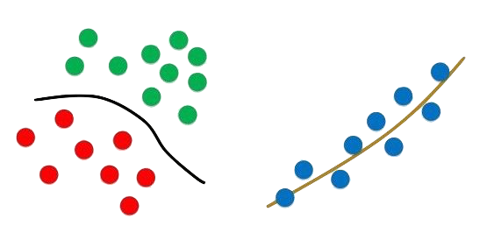
Classification vs Regression

Slide 18
The Titanic Dataset
Part1: Exploratory Data Analysis(EDA): ( DONE IN MODULE 2)
1) Analysis of the features.
2) Finding any relations or trends considering multiple features.
Part2: Feature Engineering and Data Cleaning:
1) Adding any few features.
2) Removing redundant features.
3) Converting features into suitable form for modeling.
Notes:
The sinking of the Titanic is one of the most infamous shipwrecks in history. On April 15, 1912, during her maiden voyage, the Titanic sank after colliding with an iceberg, killing 1502 out of 2224 passengers and crew. That's why the name DieTanic. This is a very unforgetable disaster that no one in the world can forget.
It took about $7.5 million to build the Titanic and it sunk under the ocean due to collision. The Titanic Dataset is a very good dataset for begineers to start a journey in data science and participate in competitions in Kaggle.
The Objective of this notebook is to give an idea how is the workflow in any predictive modeling problem. How do we check features, how do we add new features and some Machine Learning Concepts. I have tried to keep the notebook as basic as possible so that even newbies can understand every phase of it.

Slide 19
Types of Features
Categorical Features
Ordinal Features
Continuous Features
Notes:
Types Of Features
Categorical Features:
A categorical variable is one that has two or more categories and each value in that feature can be categorized by them. For example, gender is a categorical variable having two categories (male and female). Now we cannot sort or give any ordering to such variables. They are also known as Nominal Variables.
Categorical Features in the dataset: Sex,Embarked.
Ordinal Features:
An ordinal variable is similar to categorical values, but the difference between them is that we can have relative ordering or sorting between the values. For eg: If we have a feature like Height with values Tall, Medium, Short, then Height is a ordinal variable. Here we can have a relative sort in the variable.
Ordinal Features in the dataset: Pclass
Continous Feature:
A feature is said to be continous if it can take values between any two points or between the minimum or maximum values in the features column.
Continous Features in the dataset: Age

Slide 20
Coding Session

Slide 21
THANK YOU

